Slide 1

Besser
Christian Childress | Jason Logerquist | Kristade Swain

Slide 2

Focus
Create new employee suggestion system for Zublin
Employees can quickly and easily notify administration about potential new ideas
Any employee (whether blue or white collar) could suggest an idea
Potential Ideas are rated and ranked
Reviewers decide whether or not ideas should continue or end

Slide 3
Sprint 3 - Goal
Our goal for sprint 3 was to finish all the functionality we could in the time provided. We finalized the database implementations for all of our views. We improved the look and feel of the application as a whole. Most importantly, we have a fully working and usable frontend and backend application that Zublin will hopefully implement. We have a finished hierarchy of classes and views and models and an application that dynamically updates as you use it. This was our goal for this sprint. Although we did not achieve a few of our feature goals, we are confident if we had more time and a fourth team member, we could have.

Slide 4
Sprint 3 - Accomplishments
Upgraded some UI functionality for the application to make it look more visually appealing
Figured out some last minute functionality that made the application more fluid when being used
Made a very detailed and visually appealing website for our project files and project video
Will hand off code to the company in an easy manner, the files and information they need are already organized to make the application transition as simple as possible
Managed to get a moderate notification system working for managers reviewing the ideas of employees
We created a well-formatted website to display app

Slide 5
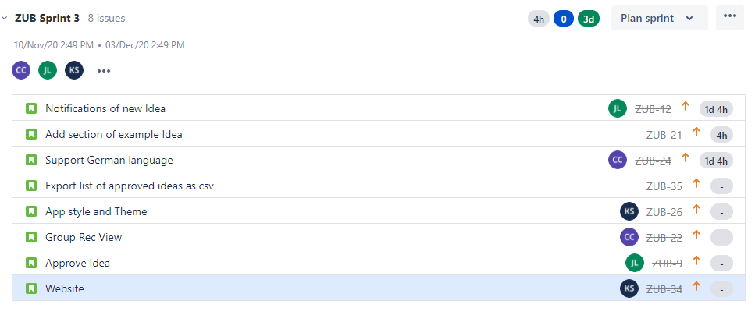
Sprint 3 - Backlog

Slide 6
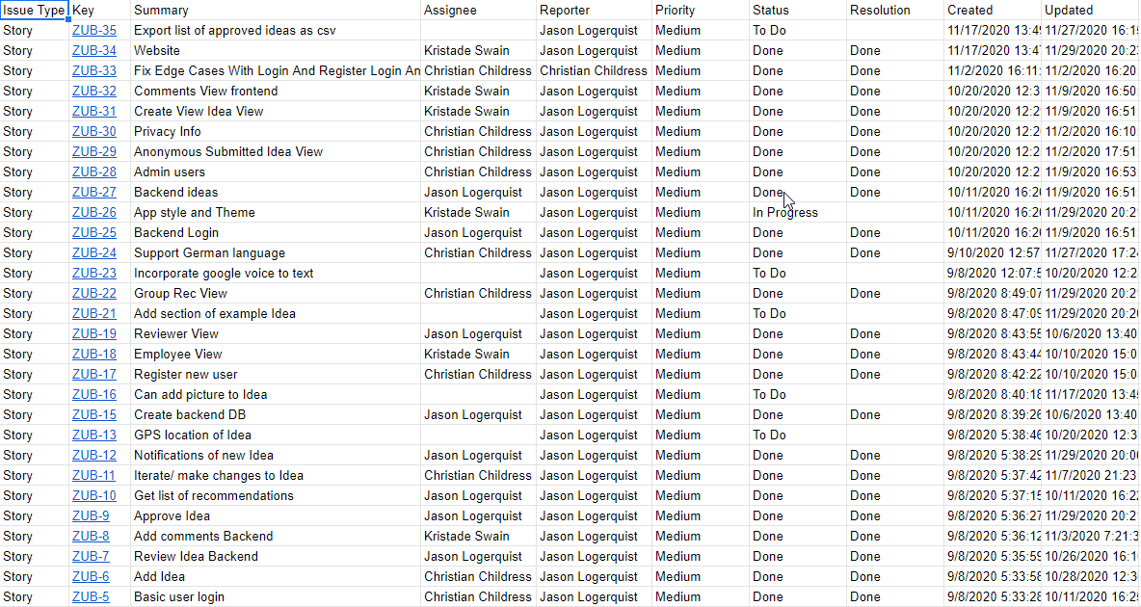
Project - Backlog

Slide 7
Overall Reflection
Basic notifications, only displays count of new ideas on a set timer
Left finalizing internationalization until the end
Ran out of time to implement stretch goals, i.e. gps location, storing audio / photos
Overall time crunch at the end of project to clean up loose ends
Did not account for break into time estimation for sprint 3

Slide 8
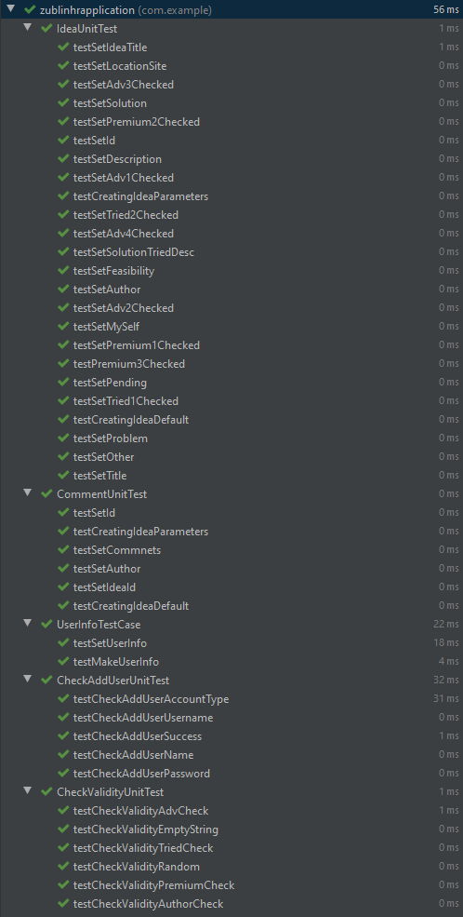
Test Cases - Passing
43/43 tests are passing

Slide 9
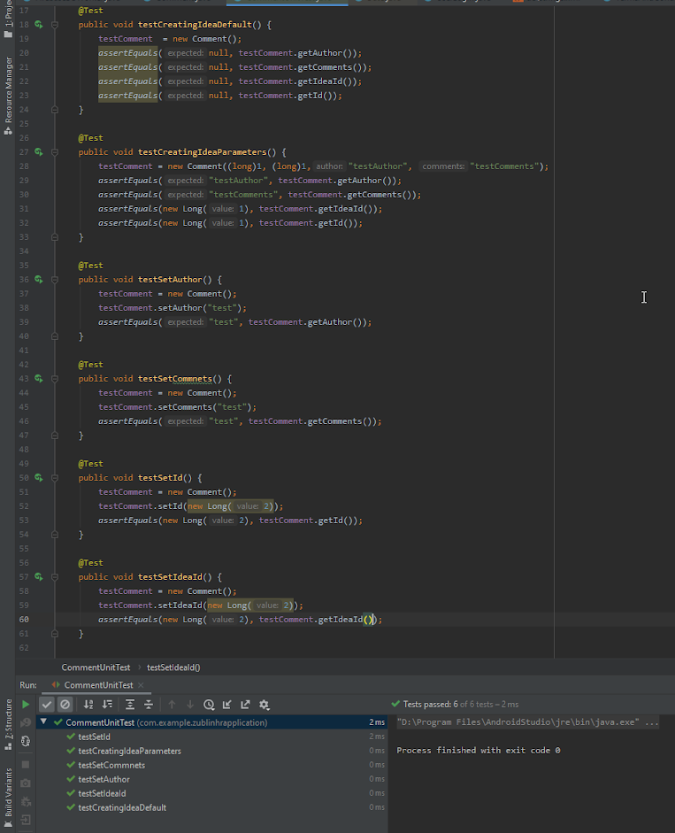
Test Cases - User Info
We added test cases related to the comments class to cover the functionality.
The purpose of the class is to store values related to the information stored about comments in our database.

Slide 10

Website Walk-through

Slide 11
Live Demo

